Slide 1

GRADUATION REQUIREMENT SIMPLIFIER
ICS 370 FALL 2020
By: Bradley Taylor, Rene Ntumnui, David Qual

Slide 2

Introduction
Our vision is to develop an application that allows Metropolitan State University Students to easily track their academic progress towards graduation.
This application will cover all major courses offered at Metro State.
The intent is to give students a clear guideline on how to accomplish their goal of graduating as efficiently as possible

Slide 3
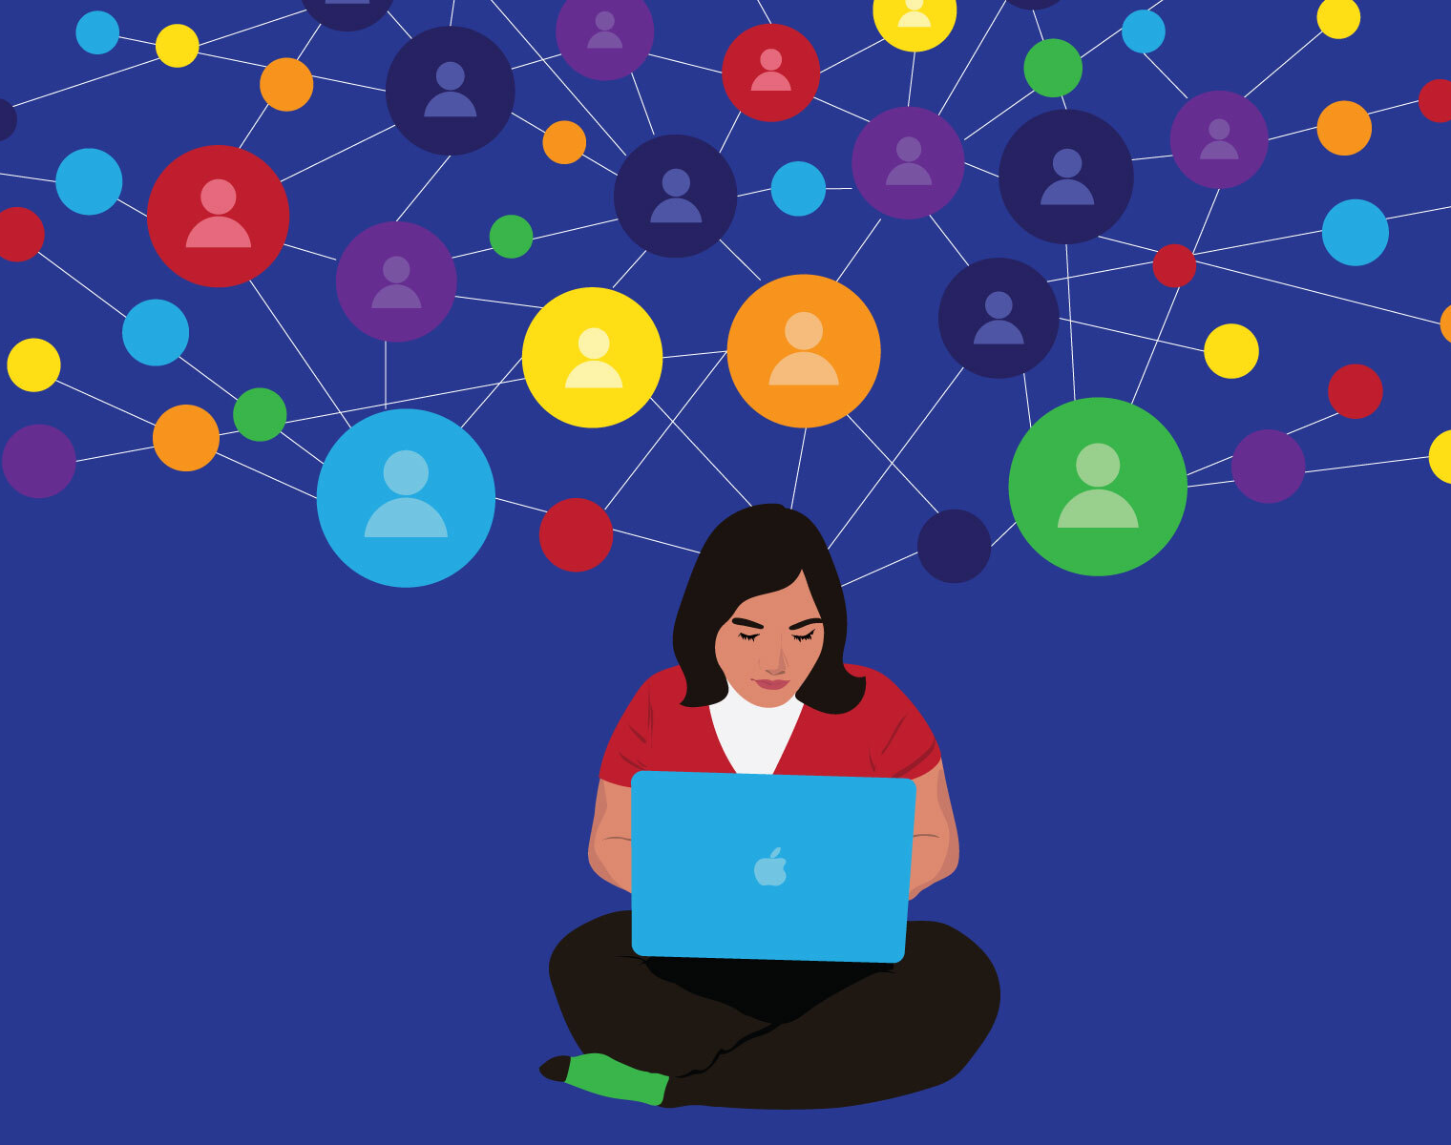
Why this Application
The average bachelor’s degree requires 120 college credits, yet the average recipient completes 134 credits before graduating.
Students change schools or major and understanding what they need is crucial.

Slide 4

Vision and Scope
The vision for this application is to give students a way to clarify their current position in any given secondary school, and to provide them the information to graduate as efficiently as possible.
This will not only house several common universities and for each major outline the most efficient way to achieve any major that is provided by a given institution.
This will include taking in a number of file types representing grades and completed classes, comparing them and updating the plan with the information, or as the student logs completed classes.

Slide 5
Other Factors
Some students don’t take full advantage of the fact that there are counselors available to them and some don’t have the desire to communicate so they spend time taking some unnecessary classes.
Degree audits can be very confusing to read which further complicates the life of a student.
This application is accessible online and it is easy to read.
Students won’t need to schedule appointments or sit down with advisors.

Slide 6
Feasibility
Our software is design to serve Metropolitan State University students. It will cover a variety of areas within the school. There will also be an exploration project to assess the potential market value of this program.
The areas of feasibility are:
Technical
Financial
Economical
Political

Slide 7
Technical Feasibility
The technical feasibility of this project was carefully assessed from two separate point of view.
The first part was project development and infrastructure. We learned that there are freeware available for us to use and in some cases, we will use low-cost subscription SaaS products.
The second viewpoint was the technological accessibility of all potential end users.
We asses that all students at Metro State have access to a laptop or desktop computer either through the school or personally.
Finally, there will be no additional hardware requirement to what is already available and there will be no cost associated with end users.

Slide 8
Financial Feasibility
Software development often come with a huge price tag because of technical and operational expenses.
We are going to eliminate these expenses because we already have the necessary hardware available.
Operationally, our staff consists of three individuals working together to meet this goal.
There is no movement from one place to the other which saves money and its convenient.
We do expect there to be minimal expenses related to software which may come in the form of licensing or subscription fees pertaining to the hosting of our solution.

Slide 9

Economic Feasibility
The economic section explores the ability of the solution to break even or potentially become profitable in the future.
We anticipate a considerable incubation period for this software to become widely used and appreciated.
Graduation requirements are not always considered daily but rather towards the end of each semester.
This factor contributes greatly to the lengthy time incubation.
Further exploration will be done to determine a break-even period because our project needs several semesters to elapse and students and advisors use and appreciate this powerful tool.

Slide 10
Political Feasibility
From the previous section, we stated that a lengthy time is required before the system is widely used and our research on political feasibility helped us conclude that assessment.
Non of the factors considered were harmful significantly or insurmountable.
Our project is designed to help students and advisors. We expect the latter to involve political implications.
The concept of improving the current system implies that a weakness or deficiency exists.
Previous experiences show that attempts made to improve a process or procedure within any organization faces backlash from current stakeholders.
We anticipate this system to be significantly beneficial to overcome those push back.

Slide 11
Market Feasibility
Our completed project will have great potential within Metro State.
We envision that students will find the solution to be intuitive and easy to use.
The system will negate the need for countless appointments with advisors and will provide a peace of mind.
Advisors will also benefit greatly.
Informed students will free up advisors'’ time and allow them to perform other essential duties and manage their caseloads more efficiently.
This application will improve students experience and advisors efficiency thus it will be coveted throughout the industry.
This factor greatly mitigates the lengthy break-even period previously discussed.

Slide 12
Software Development Methodology
We are using Agile methodology
Typical sprints are one week, ending the day before the class
We have been meeting two to three times a week including classes
This has been the standard since the first week of class
We have been utilizing Github for not only the prototype, but also the reports and presentations
There have been roughly seven meetings since the class started, with the exception of one meeting all team members have been present.
David and Rene have been awesome!

Slide 13
Student
The student will be the primary actor in our system.
The student will have to be able to login to access the interface of the program. Upon gaining access to the interface, the student will need access to several program features.
These features include the ability to select a major course of study, upload a transcript or Dars Report, run the program, and access the results. Additionally, the student will need to view, download, or print the results.
Administrator
There will be a system administrator that needs to interact with the system.
The administrator will need to be able to login to access the administrative features of the program.
Upon gaining access to the administrator interface, the instructor will need the ability to configure and maintain program majors and requirements.

Slide 14
Use Cases
Users/Actors | Use Cases/Functionalities
Student | Login Select Major Upload Transcript/Dars Report View Results Print Results Download Results
Administrator | Login Upload CSV File

Slide 15
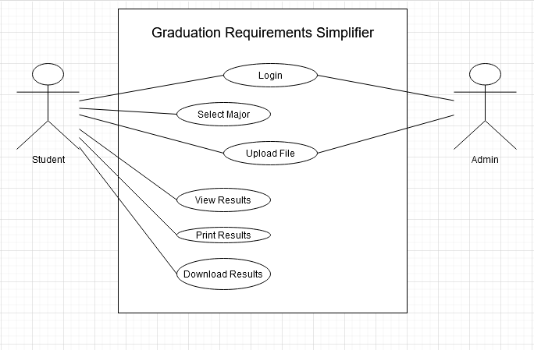

Slide 16
Estimate Cost
The average salary of a developer is around $60,000 a year.
This is going to take about 200 hours so the cost would be around $5,800.
You would probably need an analysist to test the quality of the product so another $5,800 and the total would be $11,600.
This is a web product, and you could host it yourself however, there are other options.
For example, a single instance of 100GB SSD storage, 4 core CPU, 16gb RAM from AWS is about $185 a month.
The total cost to develop, test is between $11,600 and $17400 with a monthly cost of $185 to AWS for hosting.
Theses estimates are based on current market costs.

Slide 17
Hardware and Software Requirement
For development
Realistically web development can be done with nearly any device with a text editor, so this greatly reduces the need for any high spec device or development software.
There is also a need for a database manager. We use MySQL as a database so the system would need to be able to use that.
The requirements are rather low, so an i3, 4gb of ram and 128gb hard drive (preferably an SSD) are the minimum requirements. You would also need to install the MySQL software.
For users
This would be a website with the only need being a modern browser to facilitate access to most websites.
The website would be accessible by mobile devices, but the best experience would be from a computer.

Slide 18
Project Plan
9-16-2020 to 9-22-2020
Continue documentation
Get docker container functioning to allow for web development
Begin programming a web scraper to get the majors and requirements for Metro state majors
9-23-2020 to 9-29-2020
Begin development of UI
Begin building database
Use information gathered from sources to fill in database and relations
Keep Trello board updated

Slide 19
Questions?

